Slide 1
Standard Deductions & Exemptions
Pub 17 Chapter 20
Pub 4012 Pages F-1 & F-2
(Federal 1040-Line 40)
Notes:
1

Slide 2
Standard Deduction vs. Itemized Deductions
TaxSlayer determines if it is financially better for taxpayer to take standard or itemized deductions
Taxpayer can override
Always prepare medical expenses part of Schedule A (itemized deductions), even if taking standard deduction, so that medical expenses flow through to NJ return
If taxable income is 0 based on standard deduction, no need to enter itemized deductions, other than medical expenses
Will not have to declare recoveries next year
May need to enter rest of itemized deductions if preparing an amended return
Notes:
2

Slide 3
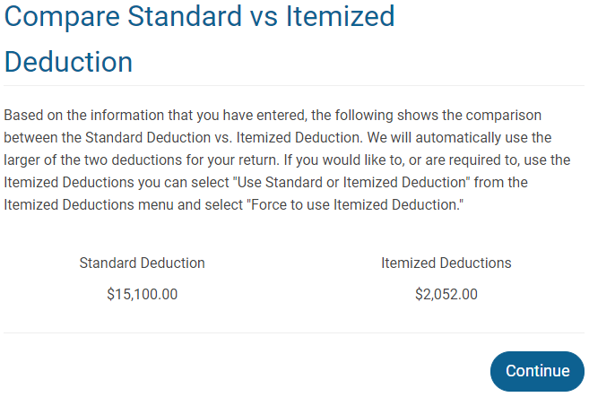
TS – Comparison of Standard vs. Itemized Deductions Federal Section \ Deductions \ Enter Myself \ Compare Deductions
Notes:
This is a screen in TaxSlayer Deduction section that shows the current comparison between the standard and itemized deductions. It is helpful to see how close your itemized deductions are getting to the standard deduction
3

Slide 4
Standard Deductions vs. Itemized Deductions
(cont’d)
Taxpayer may elect or be required to itemize deductions even though standard deduction is higher
E.g. – MFS requirement (Explained on future slide)
To force the use of itemized deductions, check box in Federal section \ Deductions \ Enter Myself \ Itemized Deductions \ Use Standard or Itemized Deduction
If taxpayer wishes or is required to take standard deduction even though itemized deductions are higher, remove some itemized deductions (not medical expenses or property taxes)
E.g. – lack of documentation to back up itemized deductions
Never required to take a deduction
Notes:
4

Slide 5
Standard Deduction vs. Itemized Deductions Federal Section \ Deductions \ Enter Myself \ Itemized Deductions \ Use Standard or Itemized Deduction
(cont’d)
Notes:
5

Slide 6
Standard Deduction
Pub 4012 Tab F
No recordkeeping required for standard deduction; back-up documentation required to itemize
Additional standard deduction allowance if over 65 or blind
No additional standard deduction for disabled on Federal return; NJ does grant additional exemption for disabled
TaxSlayer automatically determines allowable standard deduction and populates on 1040 Line 40
Based on filing status, age, blind, can be claimed as a dependent by someone else
See Pub 4012 Tab F for details and amounts for current tax year
Notes:
6

Slide 7
Situations Where Taxpayer Cannot Choose Between Standard or Itemized Deductions
Pub 4012 Tab F
Married Filing Separately (MFS)
Spouse has itemized – Taxpayer must itemize
Spouse took standard deduction – Taxpayer must take standard deduction
First spouse to file determines whether to itemize or take standard deduction
Non-resident alien or dual status alien must itemize
Notes:
7

Slide 8
2016 Exemptions & Taxable Income
Exemptions
Given regardless whether standard or itemized deductions are elected
TaxSlayer calculates: $4,050 x total # of exemptions on 1040 Line 6d (unchanged for 2017)
Populated on 1040 Line 42
Taxable Income = Adjusted Gross Income (AGI) minus (deductions + exemptions)
Populated on 1040 Line 43
Notes:
8

